Slide 1
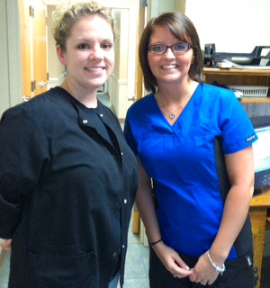
Medical Assisting Vs. Nursing
Which Career is better?

Slide 2
Medical Assistant Job Description
Perform administrative and certain clinical duties under the direction of a doctor. Administrative duties may include scheduling appointments, maintaining medical records, billing, and coding for insurance purposes. Clinical duties may include taking and recording vital signs and medical histories, preparing patients for examination, drawing blood, and administering medications as directed by physician.

Slide 3
Medical Assisting Facts:
They perform a variety of tasks that are both administrative and clinical duties.
They are paid $12.88 a hour as a beginner, in the year of 2011.
They are under a Nurse on the totem pole, but do very similar duties.
May graduate with their degree in less then a year, depending on the school.
Medical Assistants
Schedule appointments
Maintain medical records
Handle Billing
Handles Coding for insurance purposes
Vital Signs

Slide 4
Medical Assisting Benefits
- Health Plan
- Vision/Dental Insurance
- Discounts
- Paid Vacation
- Sick Leave
- Disability
- Accident & Retirement
- 401k

Slide 5

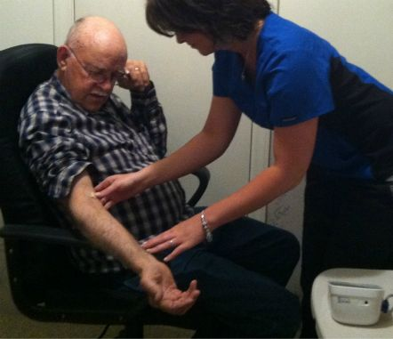


Medical Assisting

Slide 6
Registered Nurse Job Description
Registered Nurses comprise the largest group of healthcare workers. To become an RN, students must learn what it takes to work directly with patients and their families. They are the primary point of contact between the patient and the world of health care, both at the bedside and in out-patient settings. RNs perform frequent patient evaluations, including monitoring and tracking vital signs, performing procedures such as IV placement, phlebotomy, and administering medications. To as small, as taking vital signs. Because the RN is much more regular contact with patients than are physicians, the RN is usually first to notice problems or raise concerns about patient progress.

Slide 7
Registered Nursing Facts
Registered Nurses have to have a minimum of a two year degree.
Registered Nurses are right below physician assistants, which are right below doctors.
Registered Nurses minimum salary starts at $22.00 an hour, depending on the degree.
Registered Nurses receive many benefits such as
- Paid time off
- Health Insurance for you, + your family.
- Dental & Vision Insurance for you, + your family
- Pension Plans
- Tax saving plans
- Life Insurance for you, + your family
- Tuition Reimbursement
- Adoption Assistance/Child Care
- Paid Vacation
- Sick Leave
- Discounts
- 401k

Slide 8




Nursing

Slide 9






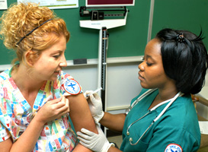
Which is a Nurse, & which is a Medical Assistant?

Slide 10
Your right, you cannot tell a difference.
*That’s because the similarities are so high.
But if you read into the facts, you’ll see surely how they differ.

Slide 11
Differences:
As you can see, Medical Assisting differs from Nursing in many ways, For example:
Pay is lower
Less Benefits for you and your family
Less respect
Medical Assistants are not able to take blood, as Nurses are.

Slide 12
Similarities:
Both Medical Assisting and Registered Nurses complete what is called patient triage (blood pressure, height & weight, temperature, etc.)
Both Medical Assistants and Registered Nurses can complete Administrative work.
Both Medical Assistants and Nurses have the choices of benefits from their Medical facility.

Slide 13
Which Career Choice is Better Overall & Why?
According to statistics, benefits, and other information; A degree as a Registered Nurse would be a better career choice overall. Nursing would better your life better then Medical Assisting in many ways, as:
More benefits for you and/or your family
More options to better your degree
More money to support your family, or you.
More opportunity’s for benefits
MORE everything!

